Slide 1
HEAD NECK CANCER- AWARENESS DRIVE
Dr. Swati Lambor
Consultant ENT, Head Neck Surgery
Manipal Hospital
Dona-Paula, Goa

Slide 2
What is a CANCER
Cancer is a class of diseases characterized by out-of-control cell growth.
Malignant tumors form when two things occur:
a cancerous cell manages to move throughout the body using the blood or lymph systems, destroying healthy tissue in a process called invasion.
that cell manages to divide and grow, making new blood vessels to feed itself in a process called angiogenesis.
When a tumor successfully spreads to other parts of the body and grows, invading and destroying other healthy tissues, it is said to have metastasized. This process itself is called metastasis, and is very difficult to treat.

Slide 3
What is a CANCER - video

Slide 4
Head Neck Cancers
Include a wide range of tumours occurring in several areas of head & neck region
Nasal cavity
Paranasal sinuses
Mouth/ Oral cavity
Voicebox/ Larynx
Pharynx – nasopharynx –oropharynx –hypopharynx
Salivary glands- Parotid –Submandibular –Sublingual
Thyroid cancers
Skin malignancies

Slide 5
Head Neck Cancers- Anatomy

Slide 6
Head Neck Cancers- Anatomy
PARANASAL SINUSES

Slide 7
Head Neck Cancers-Anatomy
SALIVARY GLANDS
THYROID GLAND

Slide 8
Some statistics…
In UK : 5-10%
Indian subcontinent : 45% of all malignancies
Men are 2-3 times more commonly affected than women.
98% of patients are >40 years of age.
15% will have another cancer in nearby area.
10-40% will develop second cancer later

Slide 9
What is special about HFN cancers?
Better patient outcome (prognosis) if diagnosed at an early stage, esp. thyroid tumours.
Affect 3 most important functions
Breathing
Swallowing
Voice
Obvious deformity after treatment.
Many are preventable.

Slide 10
CAUSES

Slide 11
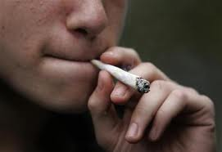
Causes
Smoking and smokeless tobacco use
Alcohol

Slide 12
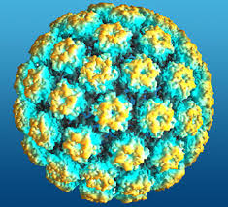
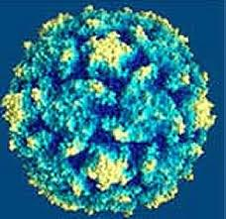
Causes
Viruses – Human Papilloma Virus (tonsil), Epstein-Barr virus (nasopharynx)
HPV
EBV

Slide 13
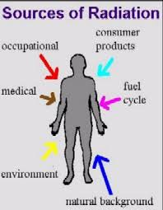
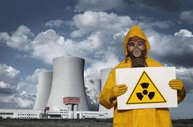
Causes
RADIATION EXPOSURE

Slide 14
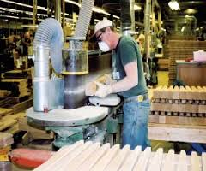
Causes
WOOD DUST EXPOSURE

Slide 15
Causes
Diet – nasopharynx, thyroid
Chemical exposure- Nickel, Chromium, Radium
Poor dental hygiene, sharp teeth
Sunlight exposure- skin
Genetic susceptibility

Slide 16
Types of HFN cancers
Squamous cell carcinoma
Adenocarcinoma
Adenoid cystic carcinoma
Lymphoma
Melanoma
Basal cell carcinoma
Sarcomas

Slide 17
Symptoms and signs

Slide 18
Symptoms one must not ignore
Mouth
White/red patch- gums, tongue, inside of cheek
Swelling of the jaw
Bleeding from mouth
Pain in mouth

Slide 19
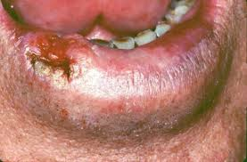
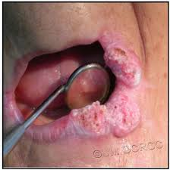
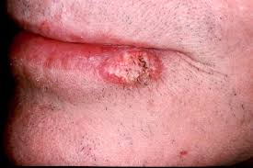
CA OF LIPS

Slide 20
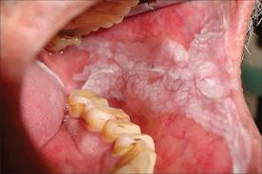
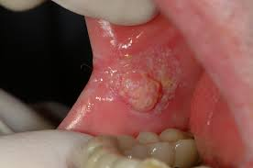
CA BUCCAL MUCOSA

Slide 21
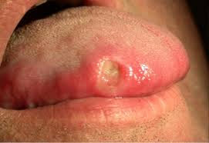
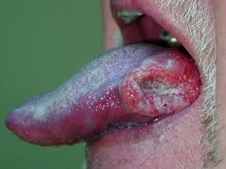
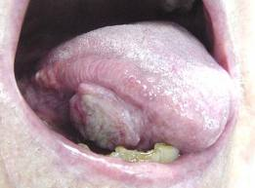
CA TONGUE

Slide 22
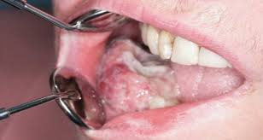
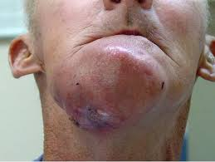
CA OF JAW

Slide 23
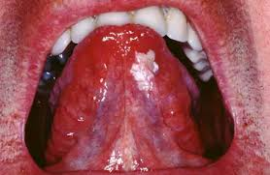
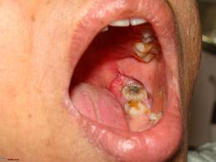
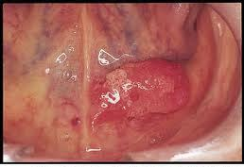
Hidden areas

Slide 24
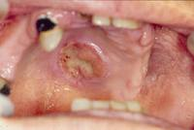
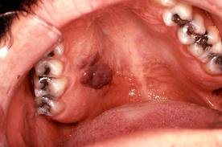
Hidden Areas
CA HARD PALATE

Slide 25
Symptoms
Nasal cavity/ sinuses
Blocked nose
Bleeding from nose
Persistent nasal discharge, blood stained
Headaches
Displacement of eye/ watering/ visual impairments
Swelling of cheek
Numbness over face
Loose upper teeth/ ill-fitting dentures

Slide 26
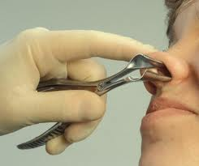
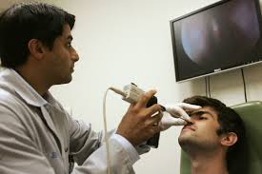
Nasal examination
SPECULUM
NASAL ENDOSCOPY

Slide 27
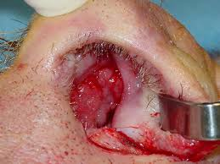
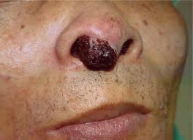
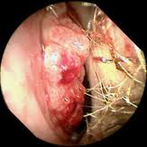
Tumours of Nose & Sinuses

Slide 28
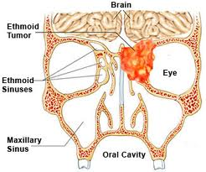
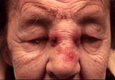
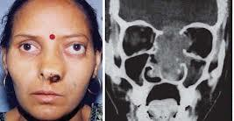
Tumours of sinuses

Slide 29
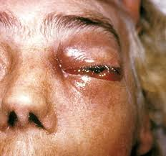
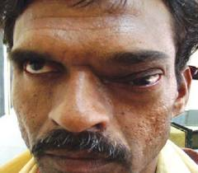
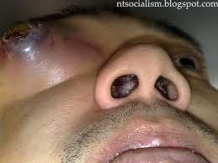
Tumours of sinuses

Slide 30
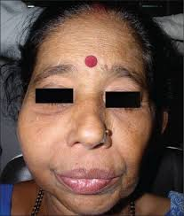
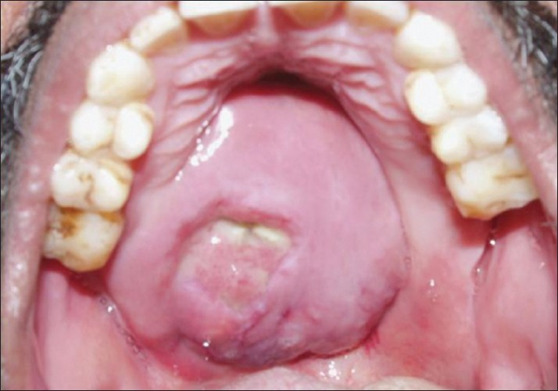
Tumours of sinuses

Slide 31
Symptoms -Pharynx
Nasopharynx
Nasal block/ discharge
Oropharynx
Hypopharynx
Foreign body sensation or pain in throat
Ear block, ringing in ears, decreased hearing, earache
Headache
Difficulty in swallowing/ breathing
Pain while swallowing
Change of voice (Hot Potato / Muffled Speech)
Bleeding from mouth

Slide 32
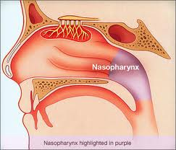
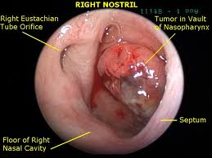
Tumour of nasopharynx

Slide 33
Symptoms -Pharynx
Nasopharynx
Nasal block/ discharge
Oropharynx
Hypopharynx
Foreign body sensation or pain in throat
Ear block, ringing in ears, decreased hearing, earache
Headache
Difficulty in swallowing/ breathing
Pain while swallowing
Change of voice (Hot Potato / Muffled Speech)
Bleeding from mouth

Slide 34
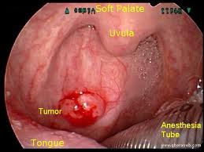
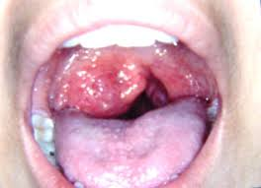
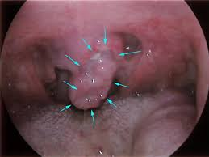
Oropharynx cancers

Slide 35
Symptoms -Pharynx
Nasopharynx
Nasal block/ discharge
Oropharynx
Hypopharynx
Foreign body sensation or pain in throat
Ear block, ringing in ears, decreased hearing, earache
Headache
Difficulty in swallowing/ breathing
Pain while swallowing
Change of voice (Hot Potato / Muffled Speech)
Bleeding from mouth

Slide 36
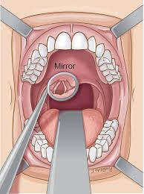
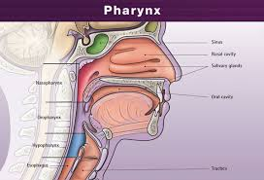
Hypopharynx/ laryngopharynx Examination

Slide 37
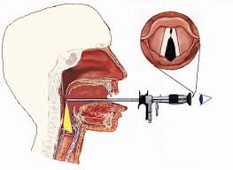
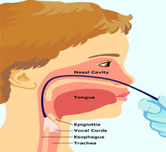
Hypopharynx/ laryngopharynx Examination
RIGID SCOPE
FLEXIBLE SCOPE

Slide 38
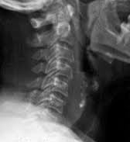
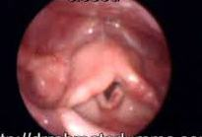
Hypopharynx/ Laryngopharynx
PYRIFORM FOSSA CA
POSTCRICOID CA

Slide 39
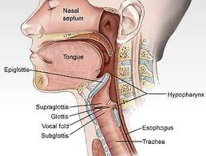
Symptoms-Voicebox/ Larynx
Hoarse voice
Difficulty in breathing
Difficulty in swallowing,
Hot potato speech
Neck swelling

Slide 40
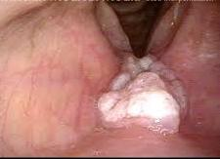
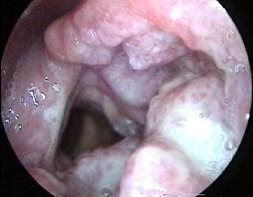
Cancers of voicebox

Slide 41
Cancers of voicebox

Slide 42
Cancers of voicebox

Slide 43
Symptoms-Salivary gland
Swelling under the chin or around the jawbone
numbness or paralysis of the muscles in the face
pain in the face, the chin, or the neck that does not go away.

Slide 44
Salivary Gland tumours
PAROTID GLAND

Slide 45
Salivary Gland tumours
SUBMANDIBULAR GLAND TUMOURS

Slide 46
Thyroid gland
Swelling in neck
Commoner in females

Slide 47
Skin cancers
Nonhealing ulcer
Enlarging skin mole/ naevus

Slide 48
Symptoms of spread - Neck

Slide 49
Symptoms of spread - Organs

Slide 50
Symptoms of spread
Lungs
Cough, hemoptysis
Liver
Pain in abdomen, jaundice

Slide 51
Symptoms of spread
SPINE
Bone pains
BRAIN
Seizures, paralysis,headache

Slide 52
To summarise the warning signs
Sore in mouth
Pain in throat
Difficulty in swallowing/ breathing
Change in voice
Loose dentures/teeth
Nasal block/ bleeding from nose
Lump/ mass in neck
Weight loss

Slide 53
What does the doctor do?
Physical examination
Investigations
Treatment options

Slide 54
Investigations

Slide 55
Investigations
Biopsy of growth/ FNAC
Blood tests
Radiological inv- USG, CT scan, MRI scan, PET scan
Aim of inv:
Identify the type of tumour
Stage the tumour- assess spread
Find the tumour
Fitness to undergo treatment

Slide 56
Investigations
NECK USG

Slide 57
Investigations
CHEST XRAY

Slide 58
Investigations

Slide 59
Investigations
NECK LN METS

Slide 60
Investigations
LIVER METS
BRAIN METS

Slide 61
Investigations
MRI

Slide 62
Investigations
PET SCAN

Slide 63
Investigations
PET SCAN

Slide 64
Treatment

Slide 65
Treatment
Surgery
Radiation therapy
Chemotherapy
Combinations

Slide 66
Surgery

Slide 67
Radiotherapy

Slide 68
Chemotherapy

Slide 69
Future advances in treatment
Minimally invasive surgery
Robotic surgery
Tissue bioengineering

Slide 70
Prevention of cancer
Avoid tobacco and alcohol.
Use of ventilators, industrial mask filters, protective clothing recommended for occupational exposure.
Diet rich in fruits and vegetables give valuable antioxidants.
Iodine rich diet for thyroid cancer prevention
Avoid midday sun

Slide 71
Take home message
Many head neck cancers are preventable.
Regular checkup is helpful.
Do not ignore the warning signs.
A healthy balanced diet should be the aim.

Slide 72
Thank you

