Slide 1
IMPORTANCE OF TOOTH REPLACEMENT
By Dr. Sapna A. Nagarsenkar
MDS (Prosthodontics)

Slide 2
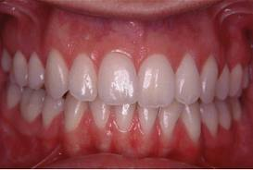
Normal dentition

Slide 3
Causes of tooth loss

Slide 4
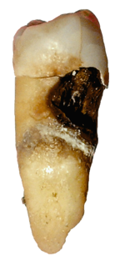
1.Dental caries

Slide 5
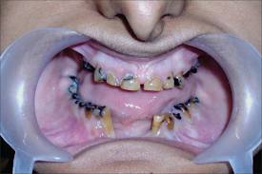
Dental caries causing mutilation of teeth

Slide 6
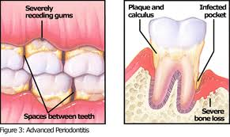
2.Advanced periodontal disease

Slide 7
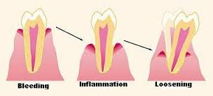
Mobility of teeth

Slide 8
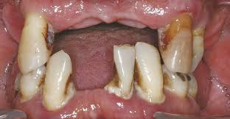
Advanced periodontitis (Clinical picture)

Slide 9
3.Trauma Horizontal fracture of teeth

Slide 10
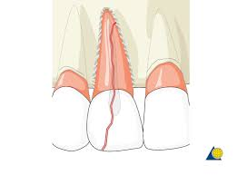
Trauma causing vertical fracture of teeth

Slide 11
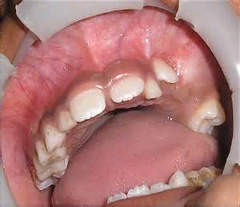
4.Oral lesions Dental cyst

Slide 12
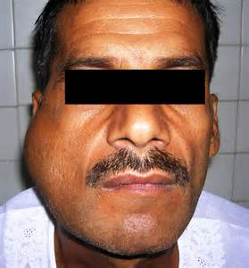
Dental tumors

Slide 13
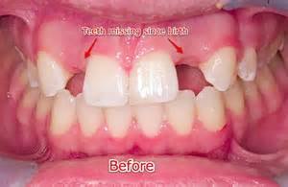
5.Congenitally missing teeth

Slide 14
Sequelae of missing natural teeth

Slide 15
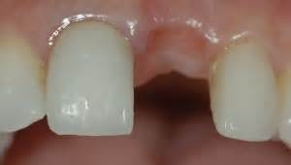
Missing anterior tooth

Slide 16
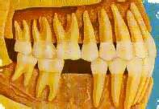
Loss of posterior tooth

Slide 17
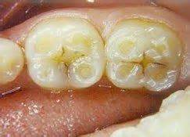
Wear facets

Slide 18
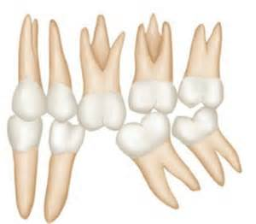
Migration of teeth

Slide 19
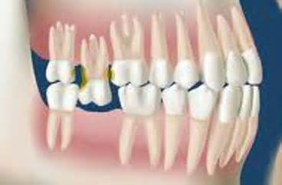
Supraeruption of opposing tooth

Slide 20
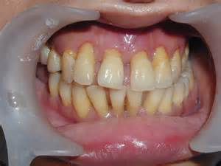
Spacing between teeth as a result of migration

Slide 21
Food lodgement causing initiation of caries and periodontal problems

Slide 22
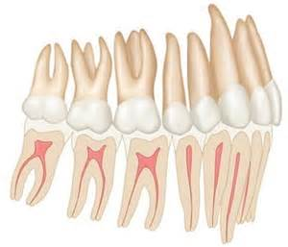
Normal occlusion

Slide 23
Occlusion deranged

Slide 24
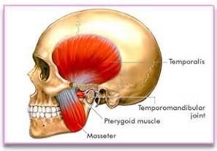
Muscles of mastication affected

Slide 25
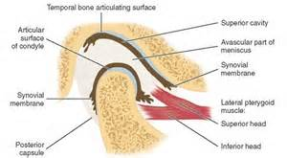
Affects temporomandibular joint

Slide 26
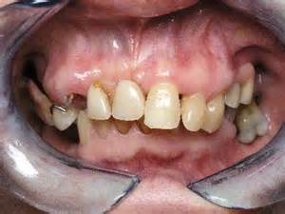
Loss of multiple posterior teeth in a single arch

Slide 27
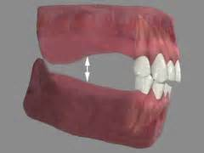
Bilateral loss of posterior teeth in both the arches

Slide 28
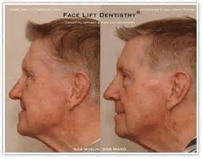
Change in facial profile

Slide 29
Mandibular rotation

Slide 30
Mandibular overclosure

Slide 31
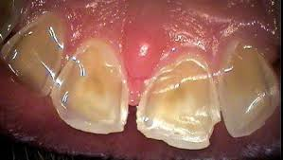
Wear of anterior teeth

Slide 32
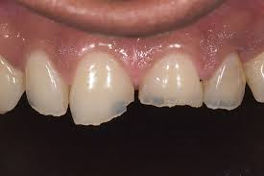
Chipping and fracture of anterior teeth

Slide 33
Muscles of mastication affected

Slide 34
Affects temporomandibular joint

Slide 35
Treatment options for missing natural teeth

Slide 36
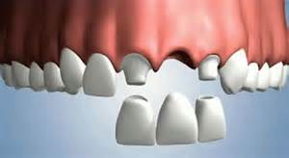
Anterior bridge

Slide 37
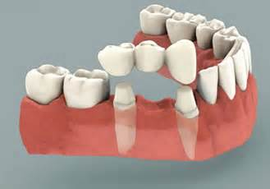
Posterior bridge

Slide 38
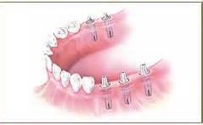
Implants for individual teeth

Slide 39
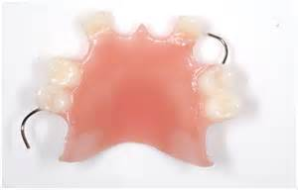
Acrylic removable partial denture

Slide 40
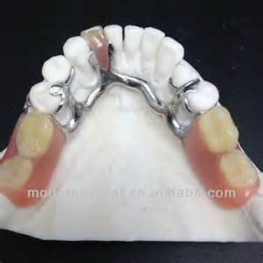
Lower cast partial denture (Removable)

Slide 41
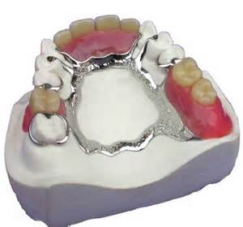
Upper cast partial denture (Removable)

Slide 42
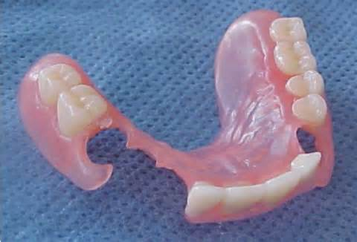
Flexi denture

Slide 43
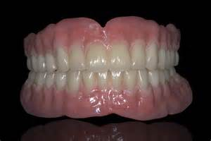
Complete dentures

Slide 44
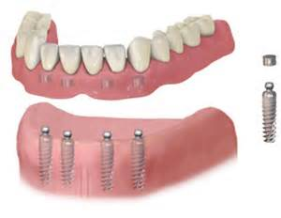
Implant supported denture(Ball & Ring)

Slide 45
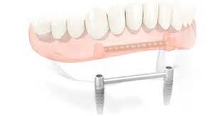
Implant supported denture (bar and clip )

Slide 46
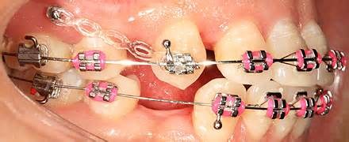
Regaining lost tooth space with orthodontics

Slide 47
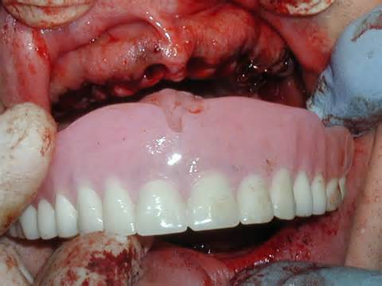
Immediate dentures

Slide 48
Thank you

